Slide 1
Lecture 32:
Nomenclature of Aldehydes and Ketones

Slide 2
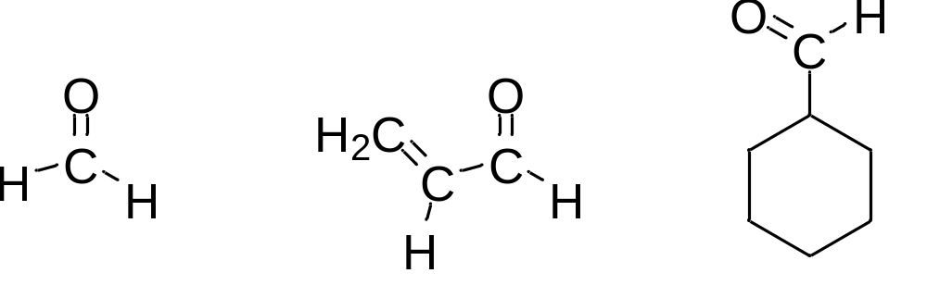
IUPAC names:
  The parent chain is the longest chain that contains the carbonyl group (C=O).
  For an aldehyde, change the suffix from -e to -al.
  For an unsaturated aldehyde, show the carbon-carbon double bond by changing the infix from -an- to -en-
  For a cyclic molecule in which -CHO is bonded to the ring, add the suffix -carbaldehyde.
  For aldehydes, start numbering at the carbonyl group
methanal 2-propenal cyclohexanecarbaldehyde
(formaldehyde) (acrolein)

Slide 3
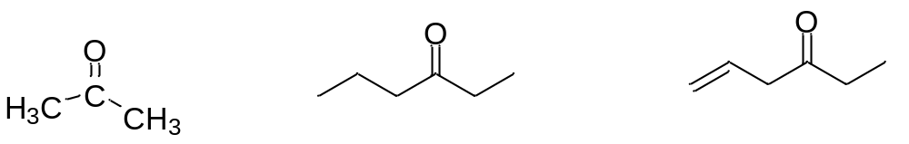
IUPAC names:
  The parent chain is the longest chain that contains the carbonyl group (C=O).
  For a ketone, change the suffix from -e to -one.
  For an unsaturated ketone, show the carbon-carbon double bond by changing the infix from -an- to -en-
  Number so that the carbonyl group gets smallest possible number
propanone 3-hexanone 5-hexen-3-one
(acetone) (ethyl propyl ketone) (ethyl 3-propenyl
ketone)

Slide 4
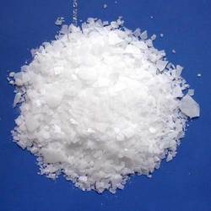
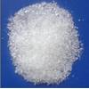
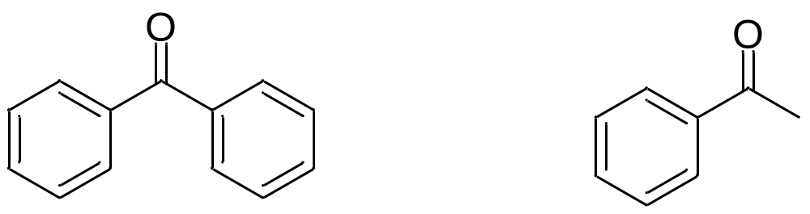
diphenylmethanone
(benzoylbenzene,
benzophenone,
diphenyl ketone)
1-phenylethanone
(acetophenone,
methyl phenyl ketone)

Slide 5
